Slide 1
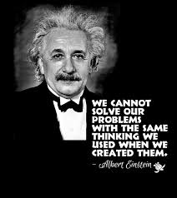
WELCOME TO STLDi INAUGURAL PRESS CONFERENCE
MAY 8, 2021 (SATURDAY @ HILTON CBD)

Slide 2
LEADERS OF SYSTEMIC CHANGE

Slide 3
Why You Have Been Invited Here
Get to know us
Understand what we do
Learn our future plans
We hope you will enjoy learning with us as leaders in your respective capacities.

Slide 4
WHAT WE DO?
SYSTEMIC STRATEGY DEVELOPMENT CONSULTANTS
SYSTEMS THINKING RESEARCHERS
LEARNING ORGANISATION THE FIFTH DISCIPLINE TRAINERS

Slide 5
What We Do
We offer strategy development consultancy for Leaders
We help leaders in organizations understand by research that developing lasting solutions to issues that are vexing & persistent in their organizations/sector sets them apart
We train organizations wanting to become Learning Organizations
Notes:
We at Systems Thinking & Leadership Development Institute (STLDi) was established in Botswana in 2012 as a strategy consulting organization developing strategic responses to the persistent matters that nations face in its efforts to becoming a developed nation. We offer training, research development and strategy consultancy for leaders.

Slide 6
DEVELOPMENT IS THWARTED AT A LATER STAGE …
WHEN PULLED BACK BY PROBLEMS THAT PERSISTS.
WHEN PERSISTENT ISSUES GO AWAY, IT WILL NATURALLY LOOK FOR THE DIRECTION TO GROW ONCE AGAIN.

Slide 7
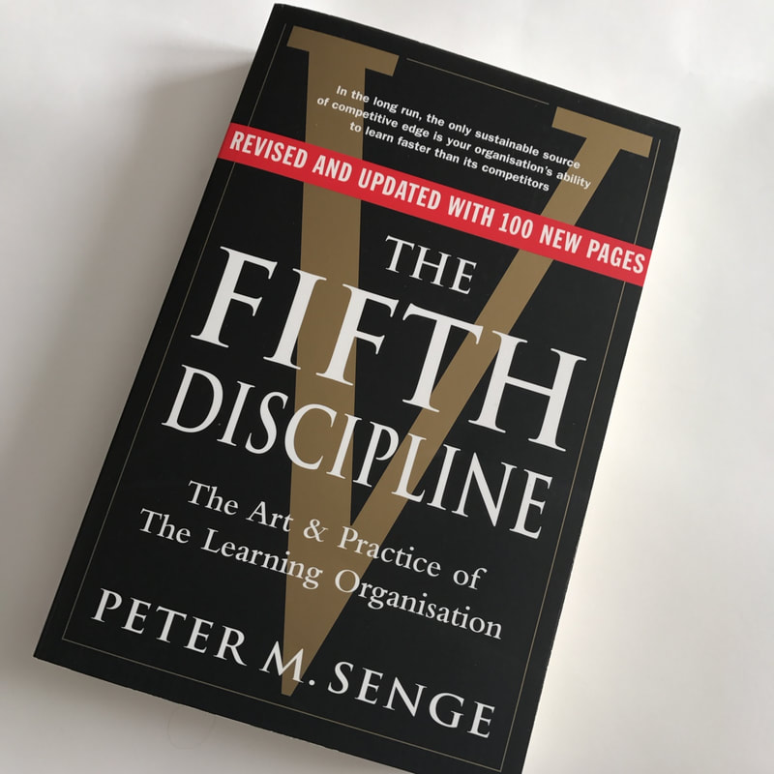
What is a Learning Organisation?
The Fifth Discipline.
Peter Senge stated in an interview that a learning organization is a group of people working together collectively to enhance their capacities to create results they really care about.
Senge popularized the concept of the learning organization through his book The Fifth Discipline.

Slide 8
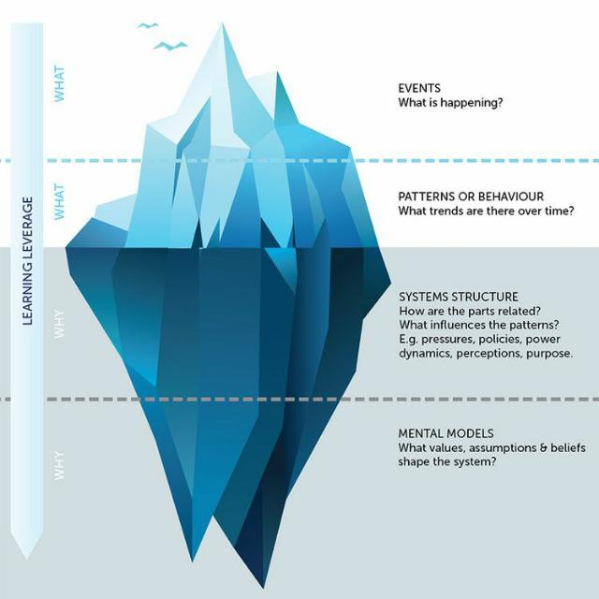
How Do We Do It?
We train leaders and managers to learn to uncover (a ‘new’ pair of eyes to see) the thinking needed to “see” the underlying structures generating the vexing /persistent problems they want to get rid off.
The Iceberg concept
That’s learning!
Notes:
We then work with you at identifying underlying (systemic) structures. It does so using the principles of the iceberg. In doing so, it identifies patterns and causal events that control the problem and therefore, its persistence. It then helps participants reverse its effects (events) but also learn to bring about what is desired (visions) in its absence. For example, seeing citizens reach for excellence and growth by nurturing the quest for learning, building shared goals and exceeding targets rather than needing to be successful to avoid failures individually.

Slide 9
What’s Our Approach to Tackling These Persistent Problems

Slide 10
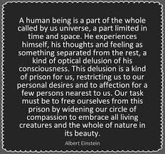

Slide 11
Any fool can know. The point is to understand.
This Photo by Unknown author is licensed under CC BY-NC-ND.

Slide 12
60 tools

Slide 13
Our Plans
We are launching a series of mini-programmes similar to what you are doing today targetting sectoral and national platforms.
The press statement is intended to help more learn about the services.

Slide 14
INTRODUCE
WHY HAS IT RESISTED EFFORTS FOR THREE DECADES TO BUCK THE TREND?
CASE STUDY: NATIONAL UNEMPLOYMENT BOTSWANA

Slide 15
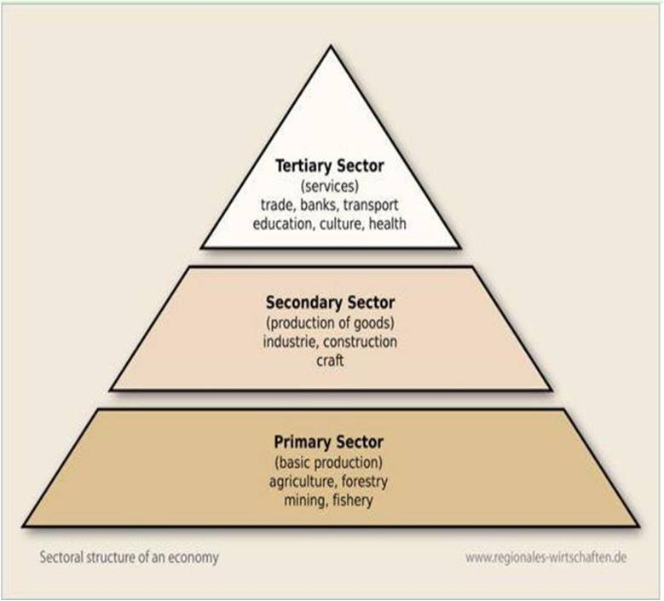

Slide 16
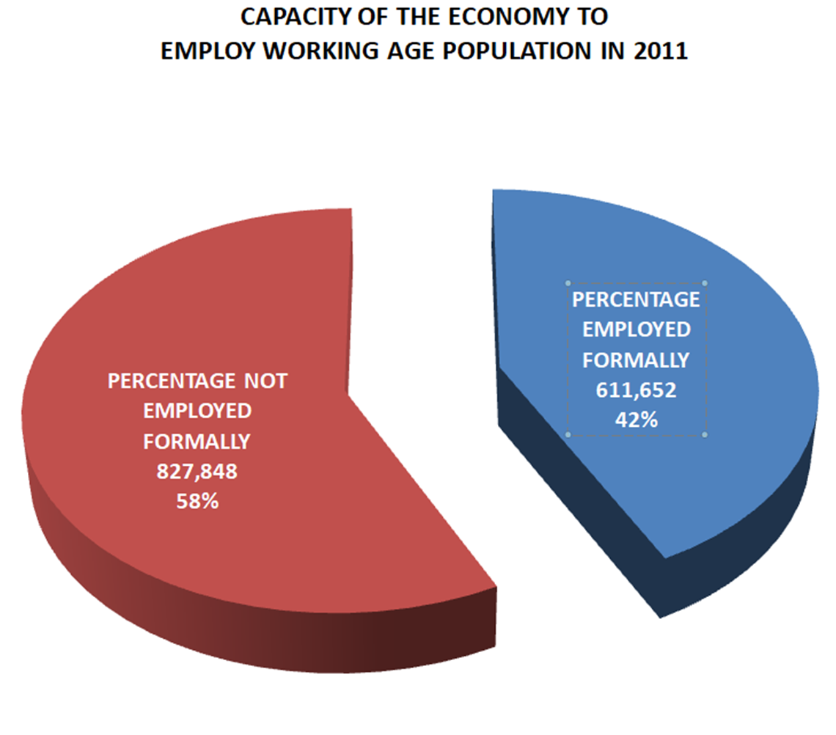

Slide 17
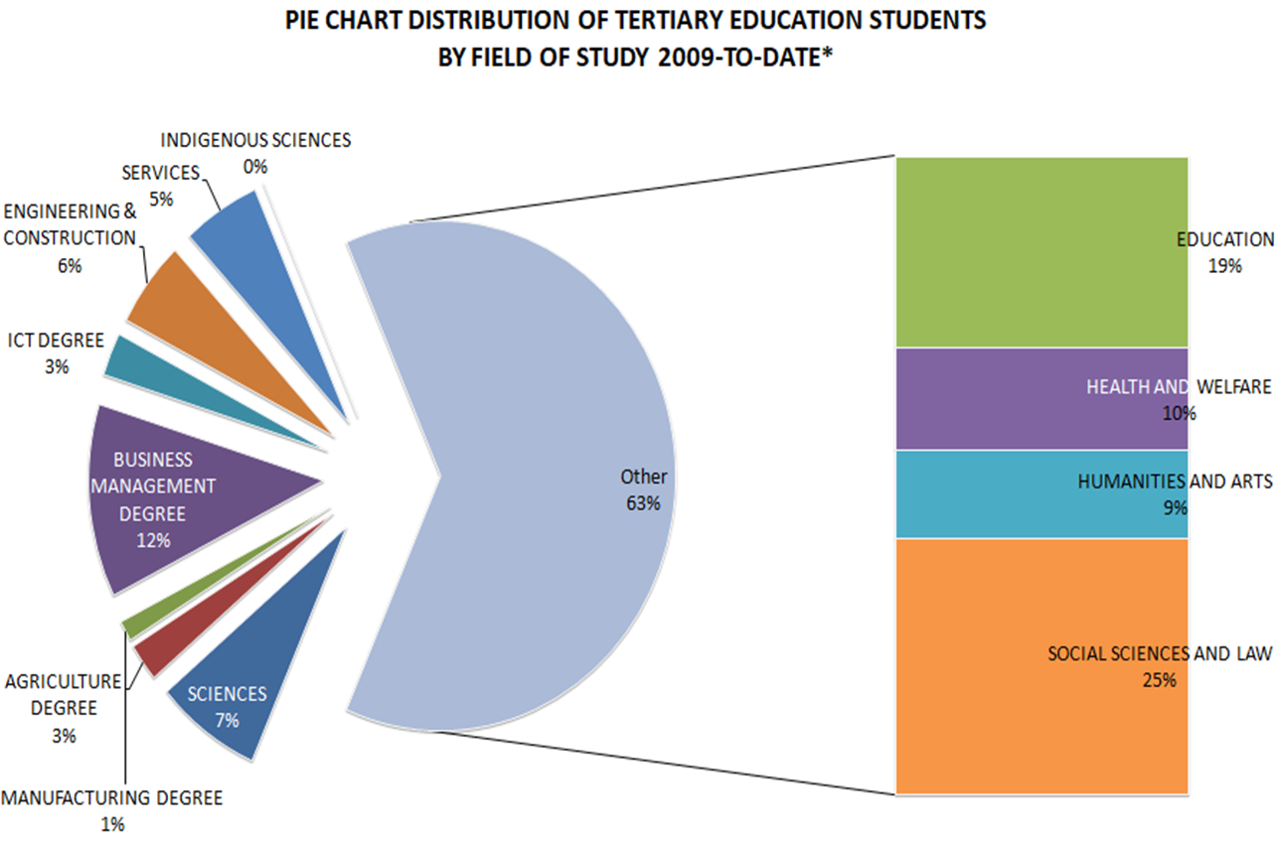

Slide 19
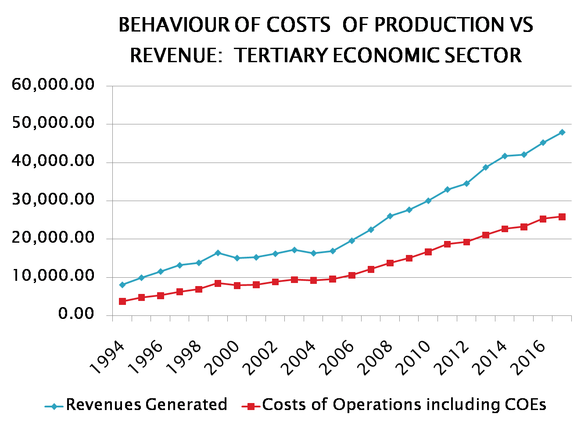

Slide 20
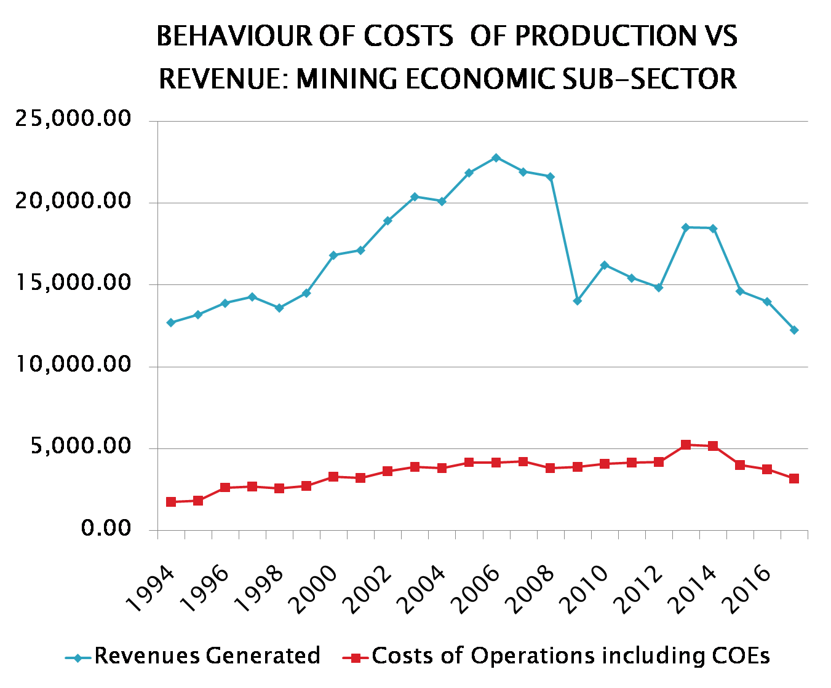

Slide 21
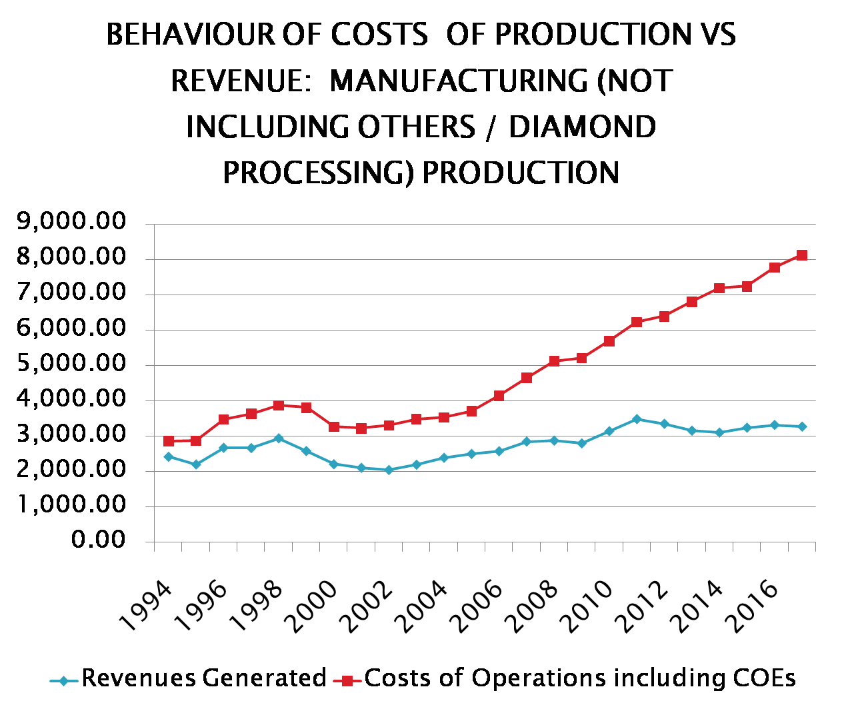

Slide 22
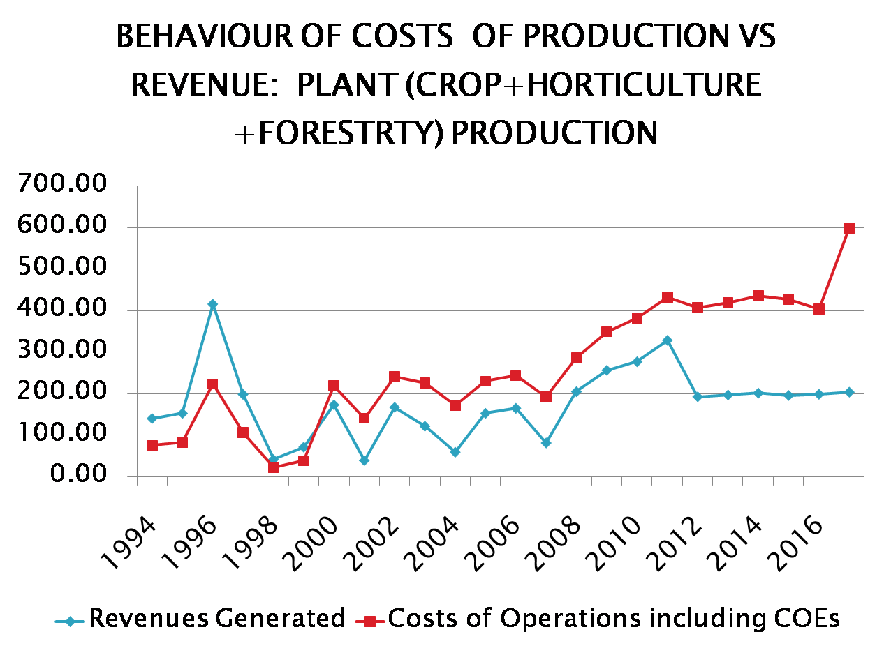

Slide 24
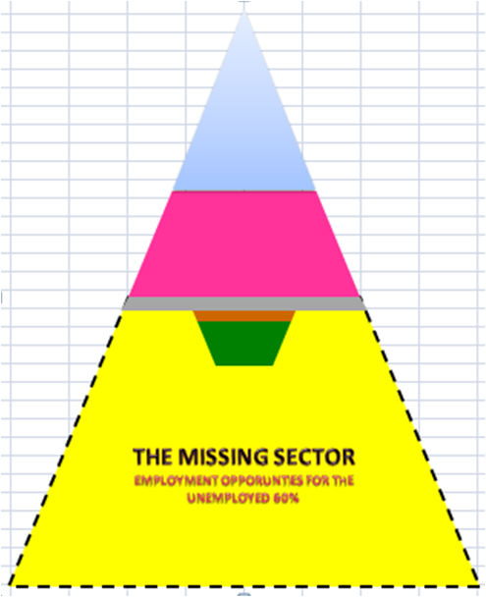

Slide 25
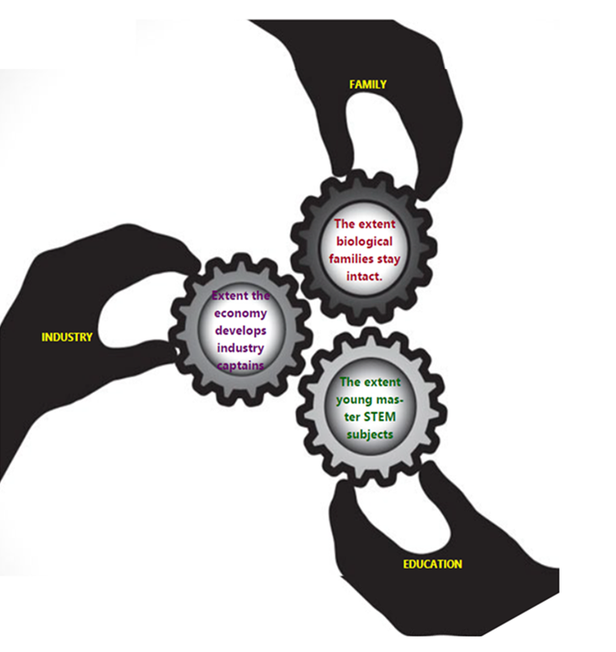

Slide 26
"Intellectuals solve problems, geniuses prevent them.

Slide 27
If you want your children to be intelligent, read them fairy tales. If you want them to be more intelligent, read them more fairy tales.

Slide 28
The only thing that interferes with my learning is my education. Albert Einstein

